Slide 1
Predicting Loan Default
Filip Bortkiewicz
May 8, 2018

Slide 2
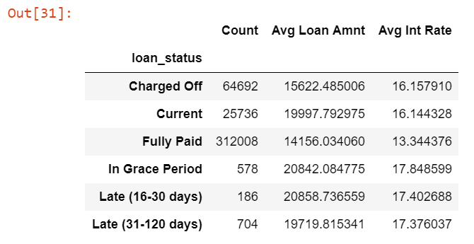

Are there factors of a loan type, borrower or loan status that can highlight risks for pending default that can then be better managed or accounted?
After cleaning, dataset from Lending Club¹ includes details of 403,904 loans issued from 2012-2014
114 data fields can be grouped on details of loan (e.g., purpose, length, interest rate), borrower (e.g., employment, home ownership, income), loan status (e.g., charge off vs. fully paid vs. current, payments) and issues with loan (e.g., late payments, hardship, recoveries)
¹ https://www.lendingclub.com/info/download-data.action

Slide 3
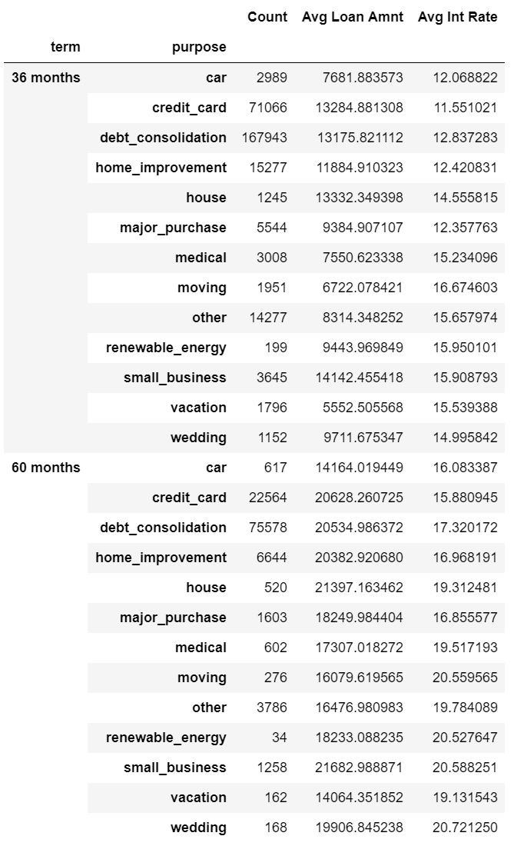
Loans Types: Majority of loans are for 36 months (72%); Most common purpose is for debt consolidation (60%)
290,092
12,484
12.8
113.812
20,274
17.2

Slide 4
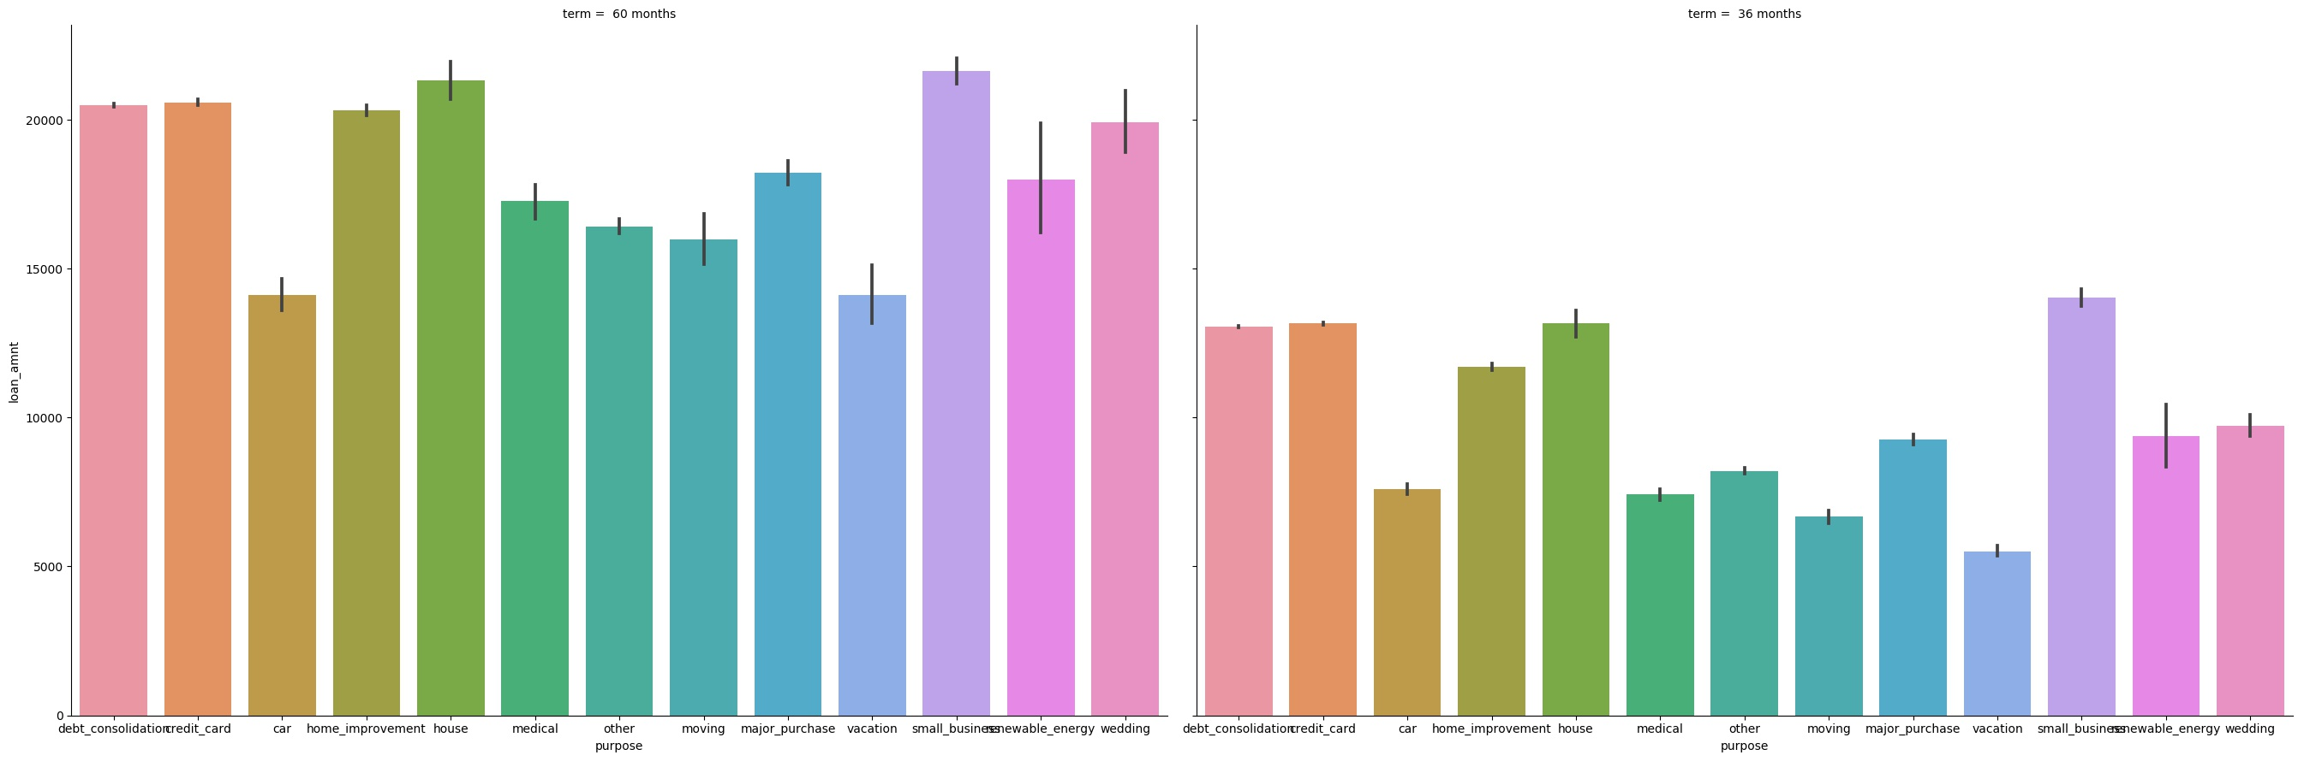
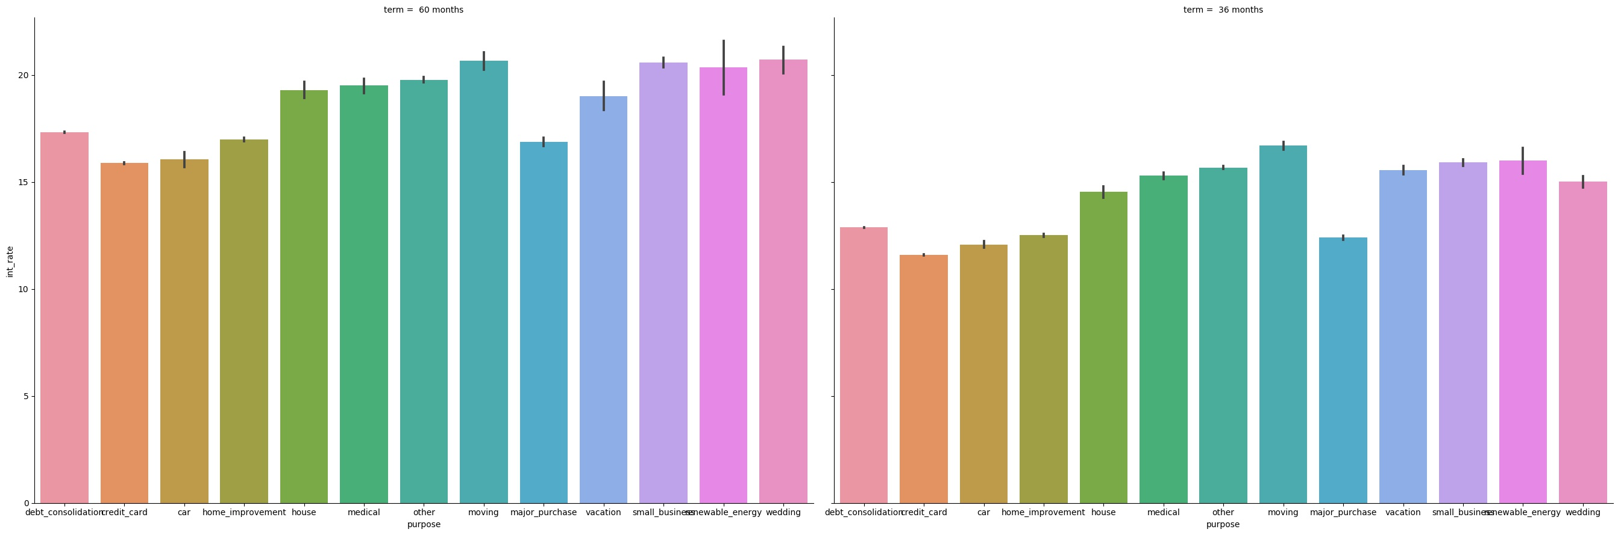
Loan Types: Longer-term loans (60 months vs. 36 months) have higher average values and interest rates; Loans for Moving have highest int rate
$20,274
$12,484
17.2 %
12.8%

Slide 5
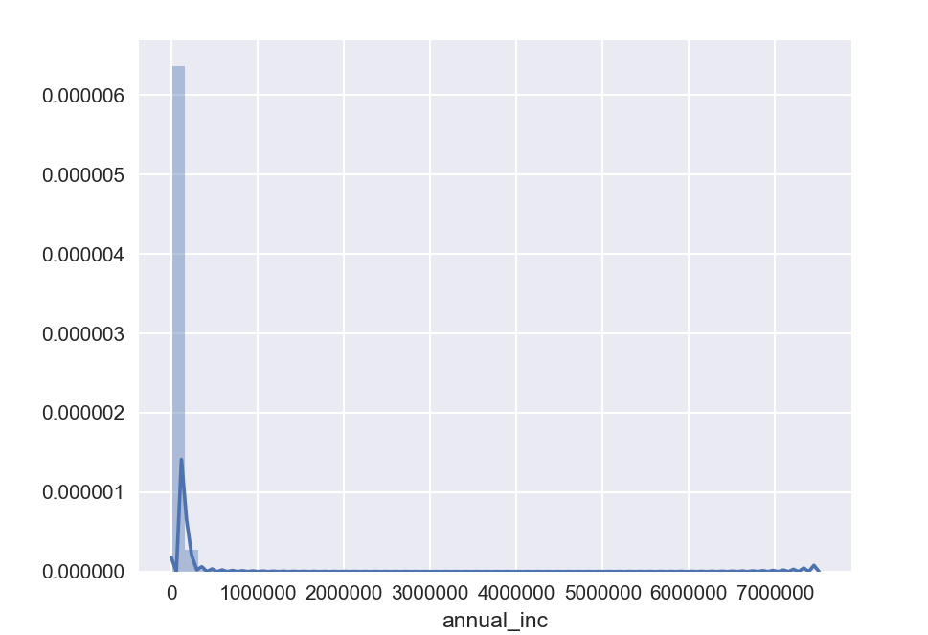
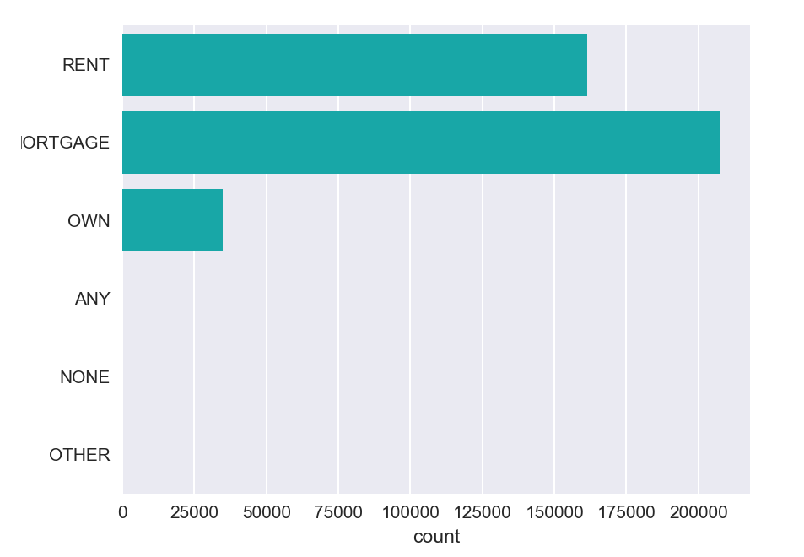
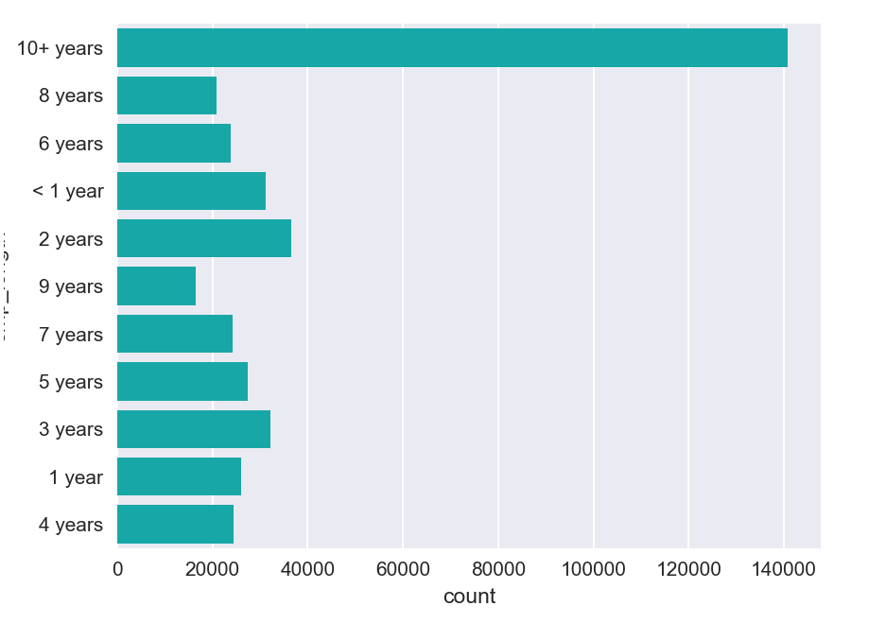
Borrower Details: Borrowers with mortgages less likely to default vs. those that rent
Employment Length:
Annual Income:
Home Ownership:

Slide 6
Next Steps
Data is for approved borrowers, therefore already excludes high risk loans that would be more easily identified as potential for default; Higher risk approved borrowers would also be visible in interest rate
In model, I believe that I should:
Exclude “Current” status loans as they could still default
Exclude “Late” and “In Grace Period” status loans as they may recover
This would result in a supervised classification model, which I could in turn apply to the excluded Current data

